Slide 1

Social Buzz Analytics

Slide 2

Description of the project
The agenda
Problem
The team of analysts
Process
Ideas
Resume

Slide 3

Description of
the project
AUDITING PRACTICES FOR WORKING WITH BIG DATA
Social Buzz it is a fast-growing IT company
that needed to adapt to global, new scales
RECOMMENDATIONS FOR A SUCCESSFUL IPO
AN ANALYSIS THAT ALLOWS YOU TO FIND THE TOP 5 CATEGORIES OF CONTENT
THE ACCENTURE TEAM HAS STARTED A POC DEDICATED TO THE FOLLOWING TASKS:

Slide 4
Problem
More than 100,000 posts per year and 36,500,000 pieces of content per year
How can I benefit from this?
YOU WILL NEED TO CONDUCT AN ANALYSIS TO FIND OUT THE TOP 5 CATEGORIES OF CONTENT IN SOCIAL BUZZ

Slide 5



The team of analysts
ANDREW FLEMING
MARCUS ROMPTON
О ЭТ Я
Chief Technical Architect
Senior Director
Data analyst

Slide 6
Process
CLEARING THE DATA
UNDERSTANDING THE DATA
DATA MODELING
DATA ANALYSIS

Slide 7

Top 5 categories

Slide 8

Popular
media formats

Slide 9
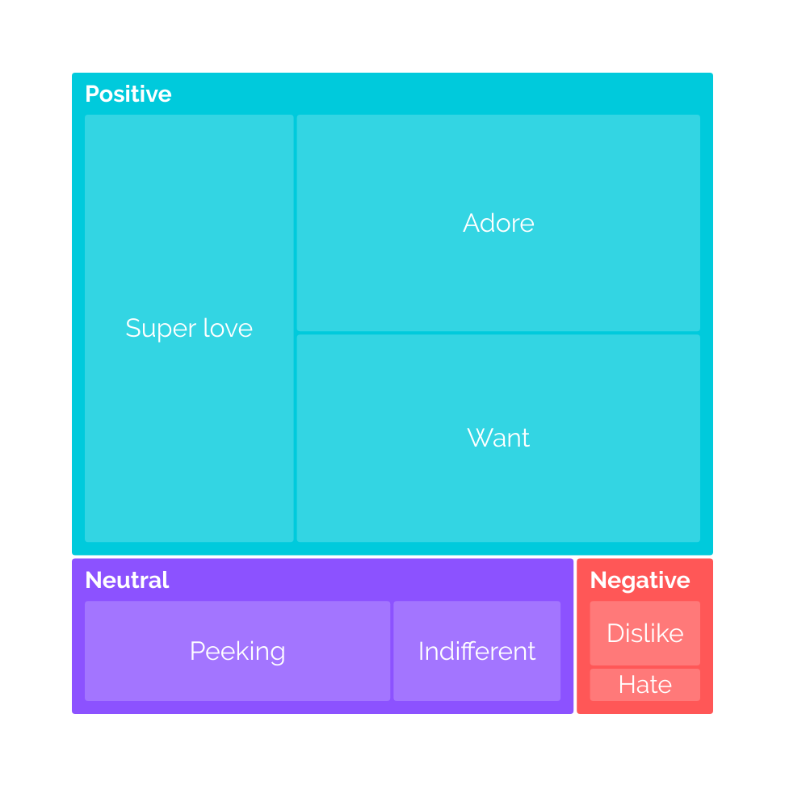
Popular
reactions
among users

Slide 10
Thank you!
ANY QUESTIONS?

